Slide 1
Xbox Hardware Overview
Xfest
August 22, 2000
Greg Gibson
Group Program Manager

Slide 2
What’s in the Box?
10/100 Ethernet port (1) (for broadband access or LAN)
A/V Interface port (1) with A/V pack
Video: composite,
S-video, HDTV,
SCART
Audio: L/R analog and
SPDIF
Power in
Modem port (1)
REAR VIEW
Power button, disc eject, and indicator lights
In the console:
Intel 733-MHz CPU
32-KB L1, 128-KB L2 cache
64-MB UMA; 6.4 GB/s;
200-MHz DDR SDRAM
5X DVD (CAV)
Hardware assist MPEG-2
decoder
>8-GB ATA/33 HDD
125M vert/s, 16 Gpix/s
Peripheral ports (4)
USB v1.1 interface with proprietary connector
FRONT VIEW
Controller
2 motors for vibration feedback
2 slots for expansion functionality
Two analog thumb sticks
All "action" buttons analog
pressure sensitive
Tray load DVD
START

Slide 3
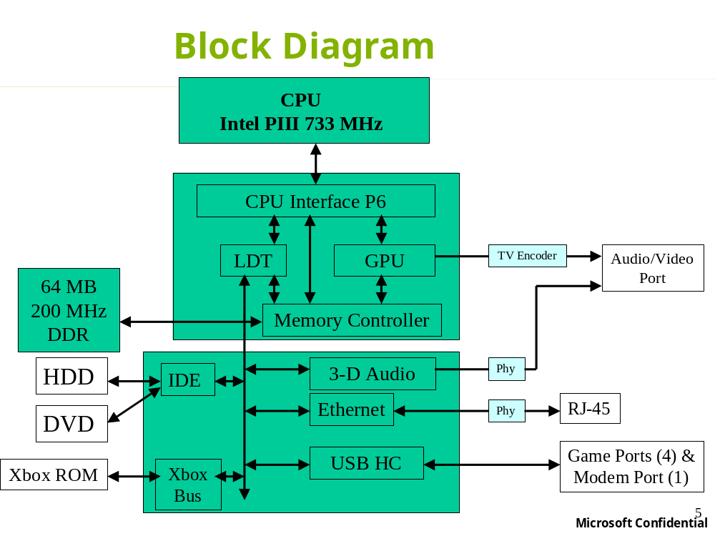

Slide 4
CPU
Intel “Coppermine” PIII Variant
733-MHz clock speed
32-KB L1 cache (16-KB data, 16-KB code)
128-KB L2 on-chip cache (full speed)
MMX and SSE instruction set extensions
1-GB/s front-side bus (133 MHz)
495-pin BGA2

Slide 5
Xbox NV2A
(Integrated North Bridge & Graphics Processor)
Front-side bus
  P6 core from Intel, at 133 MHz
  Pseudo-synchronous to memory clock for minimum latency
LDT bus to South Bridge
Memory Controllers
Graphics processing unit (GPU)
680-pin BGA

Slide 6
Graphics Processing Unit (GPU)
Clock rate: 250-MHz minimum
Geometry engine (specs assume 250 MHz)
  Transformation & lighting engine
  DX8 Compliant Programmable Vertex Shaders
  Particle rate: 125 M/s
  Gouraud triangle rate: 125 M/s (assuming 1 vert/tri)
  Textured triangle rate: 125 M/s (assuming 1 vert/tri, up to 2 textures/tri)
Pixel processing pipeline (specs assume 250 MHz)
  DX8 Compliant Programmable Pixel Shaders
  16.0 Gpixels/s effective (1.0 Gpixels/s actual; 4x fast Z occlusion; 4x anti-aliasing)
Rasterization unit

Slide 7
Memory
System Memory
  Unified Memory Architecture (UMA)
  64-MB total
  200-MHz DDR (400M cycles/sec), 128 bits
  6.4-GB/s bandwidth
  4 independent, parallel controllers:
    16 MB per controller
    4 open pages per controller
    1.6 GB/s per controller
Xbox ROM (“Bios” / Embedded OS)
  1-MB FLASH
  Xbox Bus interface ➔ < 250msec to load Xbox ROM
  FLASH update/upgrade at service center only

Slide 8
South Bridge
Audio Processing Unit (APU)
IDE — Single ATA/33 bus for HDD and DVD
USB — USB v1.1 host controller; 5 peripheral ports
Ethernet — 10/100 megabits/s
AC Link and SPDIF controllers
GPIO, SMBus, LPC, interrupt controller, RTC
324-pin BGA

Slide 9
Audio Processing Unit (APU)
Four independent hardware processors:
  Setup engine (DMA engine)
  Fixed-function DSP for voice support
  Fully-programmable DSP for effects processing
Hardware-accelerated digital audio sources:
  256 total voices, all 2-D/WT and DLS-2 capable
  Up to 64 3-D HRTF voices (I3DL2-compliant positional effects, such as reflection, occlusion, and reverb)
  Any number of voices may be submixed before 3-D and/or have effects applied, saving hardware resources

Slide 10
Hard Disk
Single-platter / single-head drive
8-GB capacity in year one
12-MB/s sustained transfer rate; 12-ms typical seek time
Holds game data and DVD/CD player applets
Does not store any part of the OS
Optimized for durability and reliability

Slide 11
DVD Drive
2x–5x DVD (CAV)
2.8–6.9 MB/s sustained data rate;
130-ms typical seek time
Compatible with DVD-ROM, DVD-V, CD-ROM XA, CD-RW (no CD-R)
Dual-layer DVD capable

Slide 12
Power Supply
Internal, open-frame supply
90W continuous (160W peak)
Three versions:
  NA (120V)
  Japan (120V with PFC)
  Europe (240V with PFC)

Slide 13
Audio and Video
Analog outputs are designed to consumer electronic standards, not PC
Video Modes:
  Composite (NTSC, PAL-I, SECAM) + S-video
  SCART (composite, S-video, RGB)
  HDTV: 1920x1080i, 1280x720p, 704x480p (YPrPb)
Audio Modes:
  Analog line level out (mono, stereo, HRTF, or ProLogic)
  Optical SPDIF (mono PCM, stereo PCM, or HRTF PCM)

Slide 14
AV Packs
NTSC Standard
  NTSC Composite Video, L/R Audio
PAL Standard
  PAL Composite Video, L/R Audio
  SCART adapter (composite only)
“Enhanced” Aftermarket Accessory
  Includes Composite Video, L/R Audio
  Adds S-video for enhanced video
  Adds optical SPDIF digital audio for enhanced audio
  Adds headphone
  Enhanced SCART (composite, S-video, and RGB) for European SKU
“HDTV” Aftermarket Accessory
  YPrPb component video output
  L/R Audio
  SPDIF
“RFU” Aftermarket Accessory
  ANT in and ANT out for older TVs

Slide 15
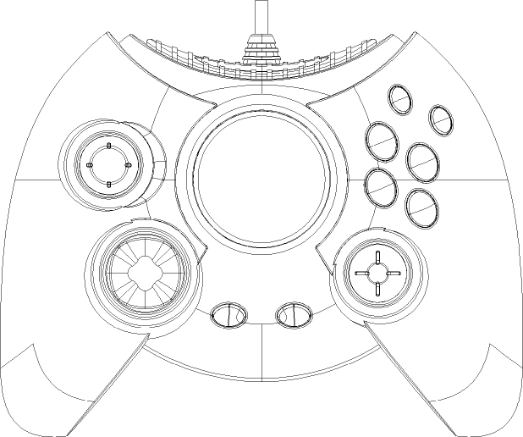
Game Controller
Custom USB interface (peripheral port)
Controller contains a bus-powered USB hub
6 analog action buttons
2 analog triggers
2 thumb sticks with switches
8-way directional pad
2 menu navigation buttons
2 vibrator motors
2 expansion module slots

Slide 16
Other Peripherals
Modem
  V.90 (56k)
  Full controller modem (CDC 1.1)
  Peripheral port interface
Memory module
  8-MB module
  Expansion port interface (in gamepad)
Voice headset for game chat
  Expansion port interface (in gamepad)

Slide 17
Summary
Please use the feedback form to give us feedback on what you’ve heard!
This talk was given by:
  Greg Gibson, Xbox Hardware
No Q&A for this talk; please hold questions for a later talk.

